Slide 1

Telecom Customer Churn Analysis & Prediction
Amruta M Menon

Slide 2
Table of contents
Introduction
Objective
Dataset Contents
Data Analysis & Visualization
Model selection & evaluation
Conclusion

Slide 3
Introduction

Slide 4
Introduction
Customer churn is defined as when customers or subscribers discontinue doing business with a firm or service.
The telecommunications business has an annual churn rate of 15-25 percent in this highly competitive market.
Customer churn is a critical metric because it is much less expensive to retain existing customers than it is to acquire new customers.
Different reasons trigger customers to terminate their contracts, for example better price offers, more interesting packages, bad service experiences or change of customers’ personal situations.

Slide 5
objective

Slide 6
objective
Predict the whether a customer churn or not by analyzing the behavior of different customers.
Here we also analyse what are the reasons that makes a customer to churn.

Slide 7
Dataset contents

Slide 8
Dataset contents
The dataset was collected from Kaggle named as Telco Customer Churn dataset.
It contains 7043 rows and 21 columns.

Slide 9
The data set includes information about:
Customers who left within the last month – the column is called Churn
Services that each customer has signed up for – phone, multiple lines, internet, online security, online backup, device protection, tech support, and streaming TV and movies
Customer account information – how long they’ve been a customer, contract, payment method, paperless billing, monthly charges, and total charges
Demographic info about customers – gender, age range, and if they have partners and dependents

Slide 10
Data Analysis & visualization

Slide 11
Data analysis & visualization
The Total Charges and tenure column was found to int and object in their data type. It has been updated to float.
The dataset was found to have 11 missing values in the Total Charges column and was filled using the mean of the Total Charges.

Slide 12
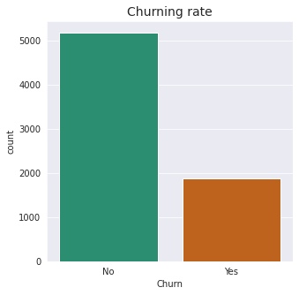
By visualizing the target variable Churn, the dataset is found to be highly imbalanced.

Slide 13
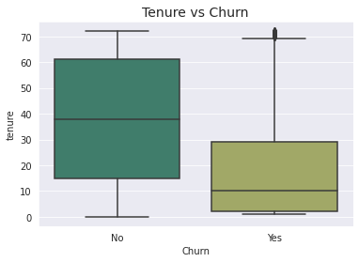
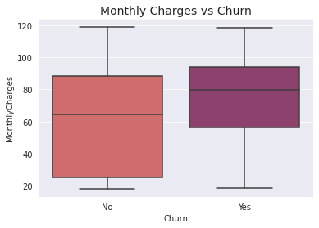
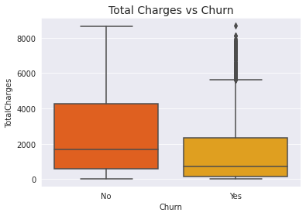
Tenure, Monthly Charges and Total Charges

Slide 14
The median tenure for the customers churned is around 10 months.
The median value of the Monthly charges of the churned customers is above 75, so the customers churned will have high Monthly charges.

Slide 15
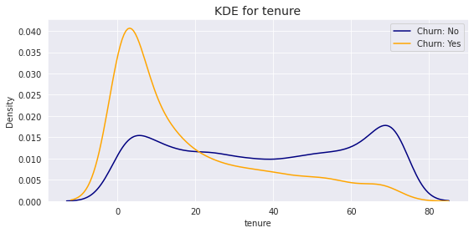
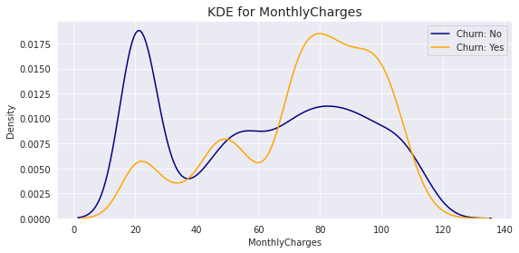
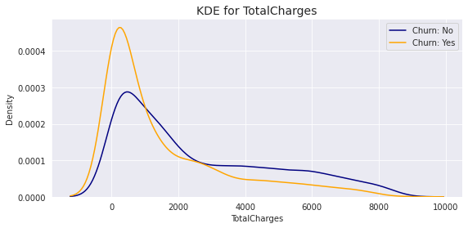
Probability distributions of Tenure, Monthly Charges and Total Charges

Slide 16
Recent clients are more likely to churn
Clients with high monthly charges churns faster
Tenure and Monthly Charges can probably be identified as the important factor affecting churning.

Slide 17
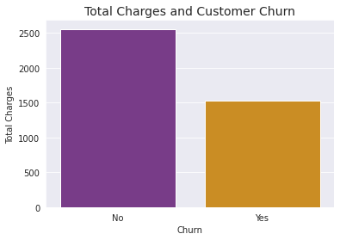
Total Charges and Churning of customers
The customers churned were having Total Charges in an average of $1531.7 and also the margin of Total charges between the customers churned and remained are also very less.

Slide 18
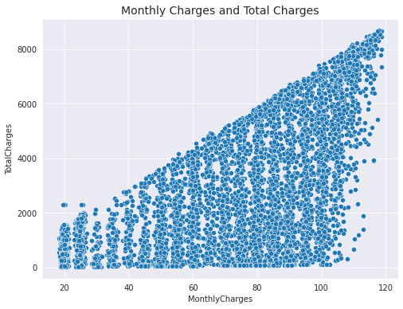
relationship between Monthly Charges and Total Charges
They are highly correlated.

Slide 19
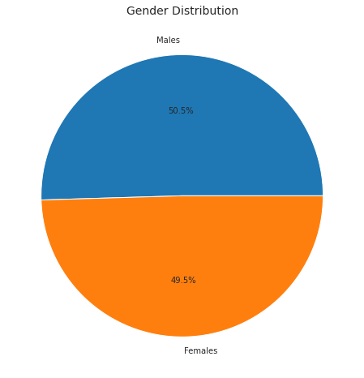
Gender composition of customers
Half of the customers are females while the other half comprises of males.

Slide 20
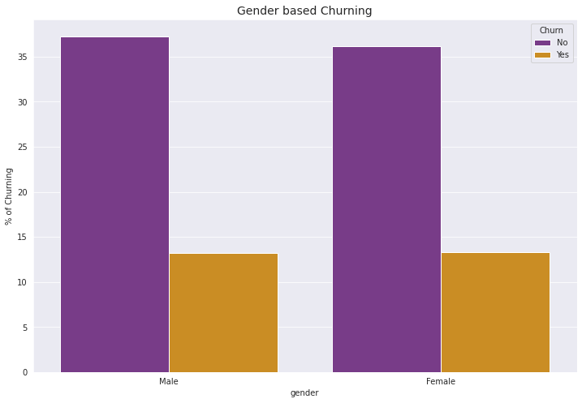
Amongst these customers, the rate of churning of male and female customers is almost the same.

Slide 21
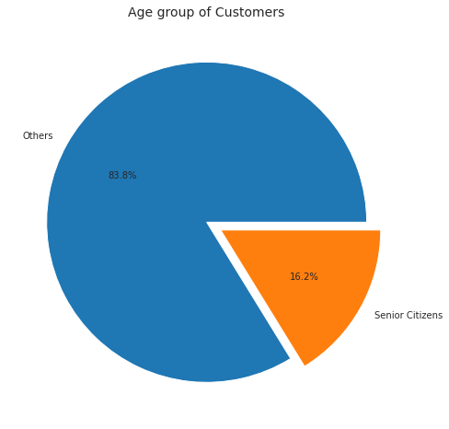
Age group of customers
Out of the whole dataset, only 16.2% are Senior citizens. 83.8% are younger people. Thus the majority of the customers are younger people.

Slide 22
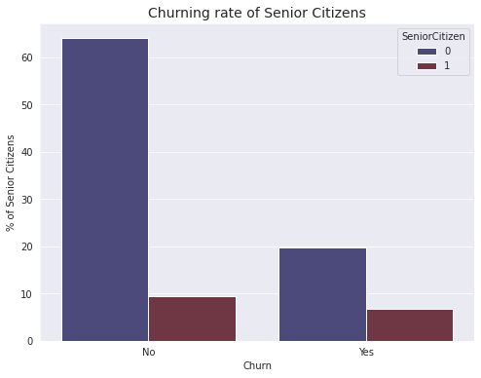
Churning rate of Senior citizens
The percentage of senior customers who left the company is very less.
The young customers have more tendencies to churn.

Slide 23
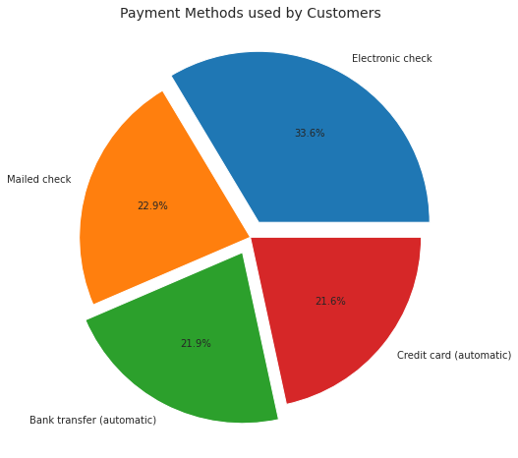
Payment methods
Electronic check is the most frequent payment method used by the customers.

Slide 24
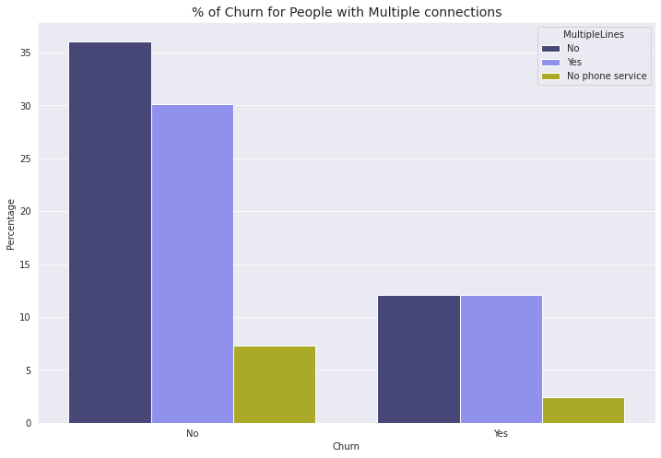
Churning rate of customers with Multiple lines
From this analysis, we found that some of the customers don’t have phone service.
The customers with and without multiple lines have almost the same churn rate. So, this cannot be identified as a factor of churning.

Slide 25
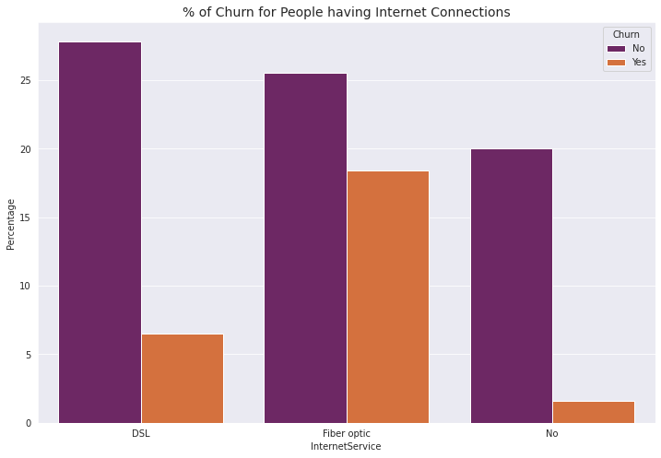
Internet service
Customers using optic fiber are more probable to churn than those using DSL connection.
The clients who has not subscribed to internet service has very low churning rate.

Slide 26
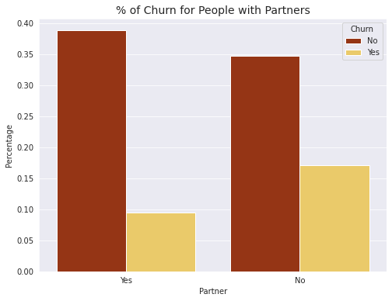
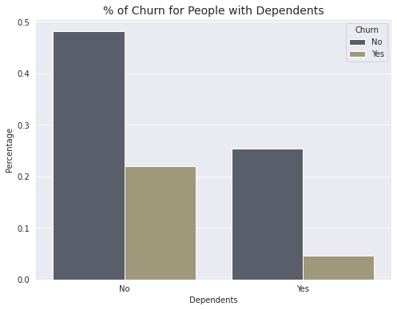
Partners and Dependents
Clients with partners are more likely to churn than that of the clients with dependents.

Slide 27
Let’s try to summarize some of the key findings from this EDA:
The dataset is imbalanced with the majority of customers being active.
Recent clients are more likely to churn and the contract period is around 10 months.
Clients with high Monthly Charges churns faster.
Monthly Charges and Total Charges are highly correlated.
Half of the customers are females while the other half is males.
Majority of the customers are younger people and have more tendencies to churn.
The customers using optic fiber are more probable to churn than those using DSL connection.
Clients with partners are more likely to churn.

Slide 28
Model selection & evaluation

Slide 29
Model selection & evaluation
Encode Categorical data
Any categorical variable that has more than two unique values have been dealt with one-hot encoding using get_dummies method in pandas here.
Split dataset into train and test
Dataset is split into training and test with an 80%-20% ratio and separated ‘customerID’ from training and test data frames.
Normalization
The training and test variables are scaled within a range of 0 to 1.

Slide 30
Dealing with class imbalance using Synthetic Minority Over-sampling Technique
Class imbalance has been dealt using SMOTE and the resampled dataset is used for training and testing.
Model selection and evaluation
Logistic Regression
Decision Tree Classifier
K- Nearest Neighbors

Slide 31
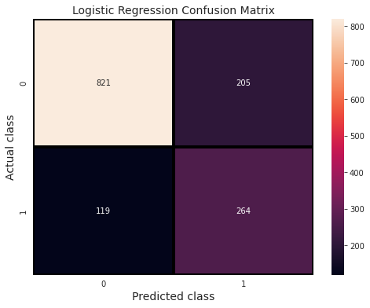
Logistic Regression
The Logistic Regression model was giving an accuracy of 77%.
The model was able to predict 264 churners out of 383 churners and from the classification report the precision was found to be 0.56, recall was 0.69 and the F1 score was 0.62.

Slide 32
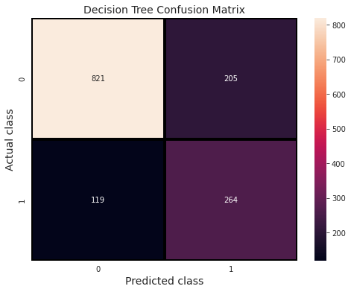
Decision Tree Classifier
Decision Tree algorithm was giving an accuracy of 77% which is the same as that in Logistic Regression.
Also the precision, recall and the F1 score was found to be the same. The model was able to predict 264 churners out of 383.

Slide 33
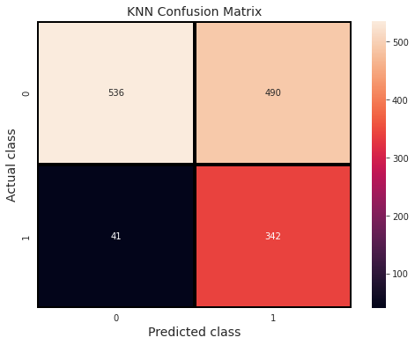
K- Nearest Neighbors
KNN accuracy score was too low, only 62% .
Also the Type 2 error was very high and the method was time consuming.

Slide 34
Conclusion

Slide 35
conclusion
After performing the analysis and applying different Machine Learning Algorithms, we can say that out of the three models, decision tree and logistic regression were more accurate in predicting the values and we were able to get an accuracy of 77%.

Slide 36
thank you

